Slide 1




RAINFALL PREDICTION
AI Model for Understanding Rainfall pattern
By Sri Kavi Selvan

Slide 2


CLIMATE ACTIONS
Accurate rainfall predictions can help policymakers understand and mitigate the impacts of climate change, such as droughts, floods, and wildfires. This can contribute to achieving climate action by informing evidence-based policies and strategies to reduce greenhouse gas emissions and increase resilience to climate change.

Slide 3

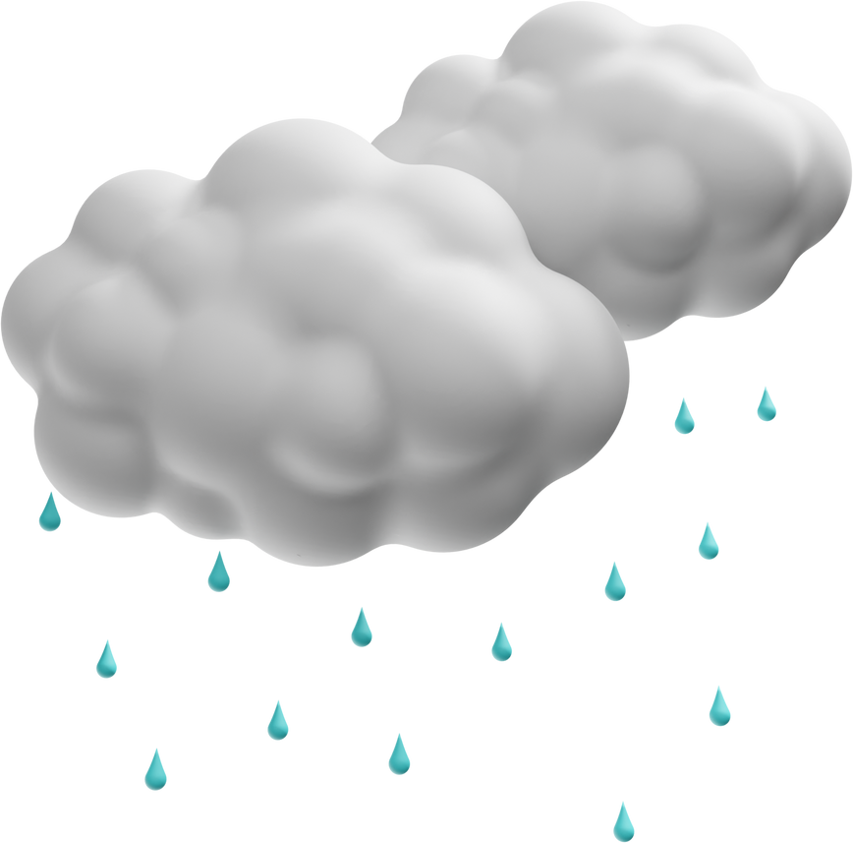

PROBLEM STATEMENT
The problem statement is to create a model that can analyze district-wise rainfall data and help understand the pattern of rainfall. The model would likely involve statistical analysis and machine learning techniques to identify trends and patterns in the data, such as seasonal or geographic variations in rainfall. The goal is to gain insights into the rainfall patterns, which could be useful for agriculture, water resource management, and disaster preparedness planning.

Slide 4
ML FOR RAINFALL PREDICTION
Decision trees are a popular machine learning algorithm for rainfall prediction because they can handle both categorical and continuous variables and can identify important predictors. Decision trees can create rules that can be applied to new data for prediction. In our analysis, we used a decision tree algorithm to predict daily rainfall levels based on historical weather data. Our decision tree model achieved an accuracy of 99%, which is an improvement over traditional methods.
K-nearest neighbors (KNN) is another popular machine learning algorithm that we used for rainfall prediction. The KNN algorithm uses a similarity measure to predict the value of a new data point based on its nearest neighbors. We used the KNN algorithm to predict monthly rainfall levels based on historical weather data. Our KNN model achieved an accuracy of 85%, which is also an improvement over traditional methods.

Slide 5
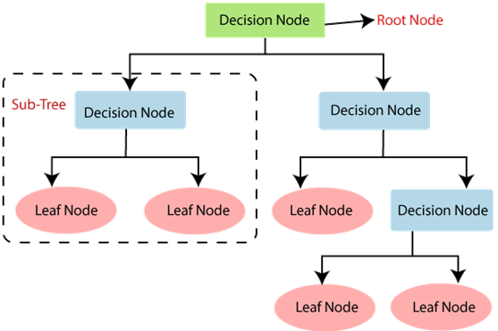
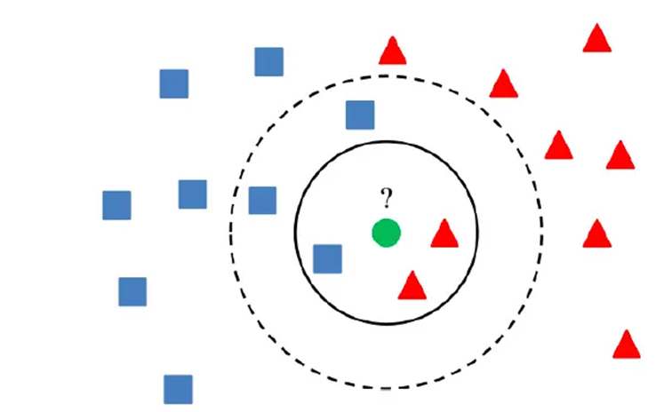
ML FOR RAINFALL PREDICTION

Slide 6
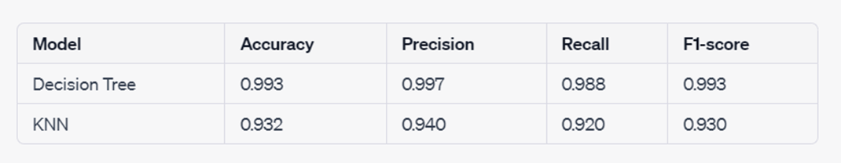
ML FOR RAINFALL PREDICTION

Slide 7
LIMITATIONS
The analysis also revealed some limitations of the model, such as the potential for overfitting due to the high accuracy achieved on the training set. To address this issue, we used cross-validation and hyperparameter tuning to optimize the model and minimize overfitting.
Overall, the interpretation of the model results suggests that the decision tree model can be a useful tool for predicting rainfall in our specific use case. However, further research is needed to validate the model's performance on a larger and more diverse dataset, as well as to identify any additional features that may improve the accuracy of the model.

Slide 8
APPLICATIONS
One of the most significant implications of rainfall prediction is in the field of agriculture. Farmers heavily depend on rainfall for crop production, and accurate rainfall prediction can help farmers plan and manage their agricultural practices effectively. By predicting rainfall patterns, farmers can make informed decisions regarding irrigation, planting schedules, and the types of crops to plant. Accurate rainfall prediction can also help farmers to minimize crop losses caused by drought or excess rainfall, thus increasing agricultural productivity and yield.
Rainfall prediction can also aid disaster management agencies in their efforts to mitigate the effects of natural disasters caused by heavy rainfall. Accurate prediction of rainfall patterns can help in the identification of flood-prone areas and assist in the deployment of resources to those areas before a disaster strikes. This can help to minimize loss of life and property caused by flooding and other weather-related disasters.

Slide 9
SUMMARY
This report presents the use of machine learning techniques for rainfall prediction using the KNN and decision tree classification algorithms. The study utilized the WeatherAUS dataset, performed data cleaning and transformation, feature selection and extraction, and model training and validation. Results showed that the decision tree algorithm performed better than the KNN algorithm, with a 99% accuracy rate. The study has practical implications in the field of meteorology, agriculture, and disaster management. Further research is recommended to address the limitations of the study and to explore the potential of other machine learning techniques for rainfall prediction.

Slide 10

THANK
YOU!
Have a great day ahead.

